Slide 1
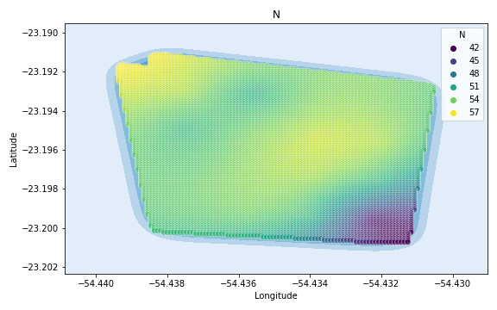
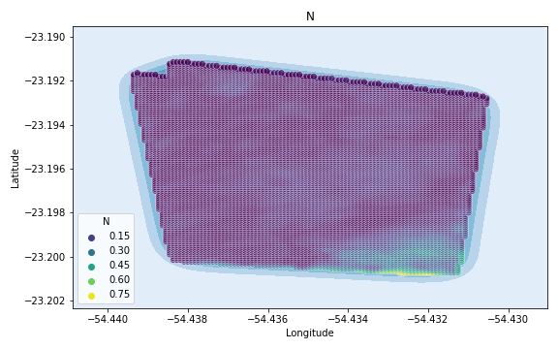
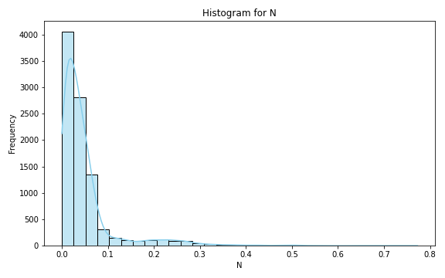
Analysis for column: N Model: Neural Network
Statistics:
mean 5.026728e-02
std 7.152503e-02
min 9.923118e-07
25% 1.399688e-02
50% 3.099271e-02
75% 5.431184e-02
80% 6.072320e-02
85% 7.100007e-02
90% 9.759446e-02
95% 2.071022e-01
99% 3.478121e-01

Slide 2
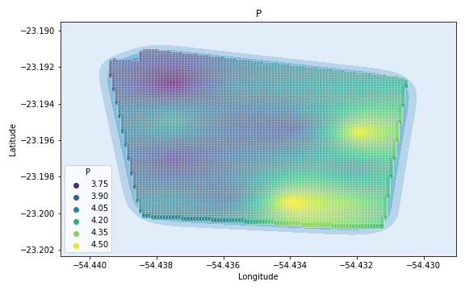
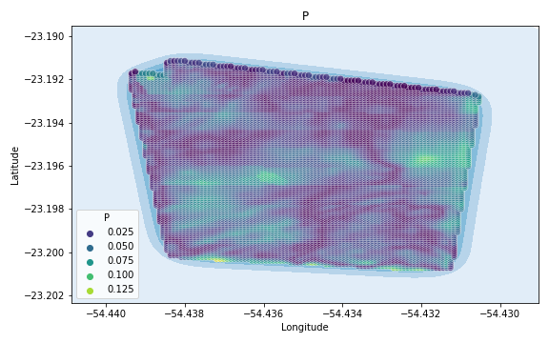
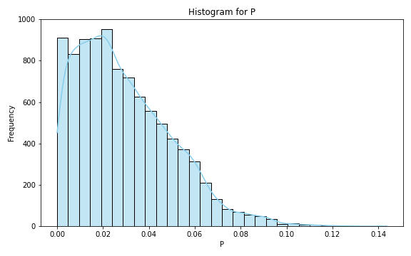
Analysis for column: P Model: Neural Network
Statistics:
mean 0.029286
std 0.020809
min 0.000010
25% 0.012873
50% 0.025229
75% 0.042395
80% 0.046925
85% 0.052000
90% 0.058126
95% 0.066796
99% 0.089826

Slide 3
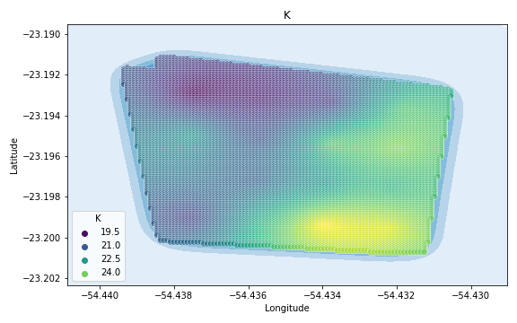
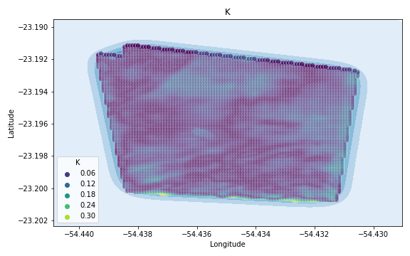
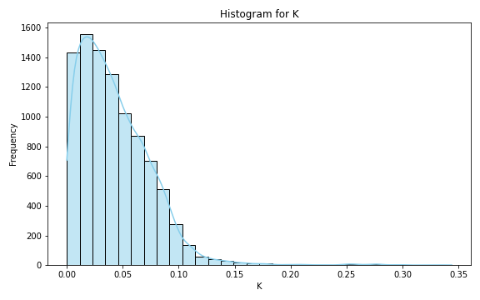
Analysis for column: K Model: Neural Network
Statistics:
mean 0.043027
std 0.033126
min 0.000002
25% 0.018394
50% 0.036799
75% 0.061789
80% 0.068148
85% 0.075099
90% 0.083894
95% 0.096165
99% 0.141849

Slide 4
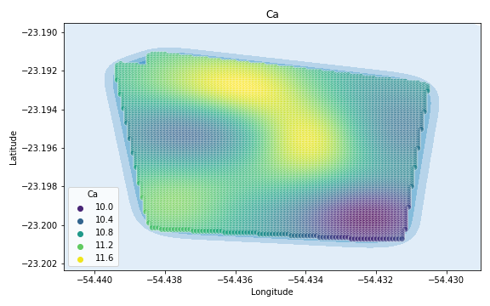
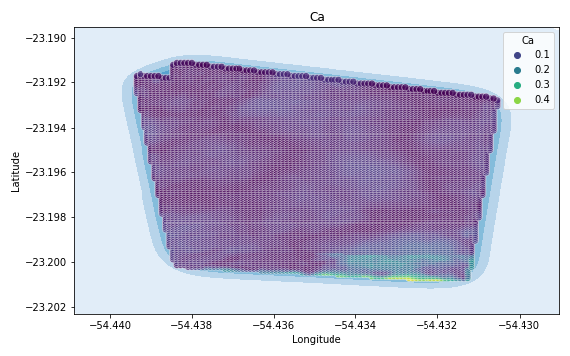
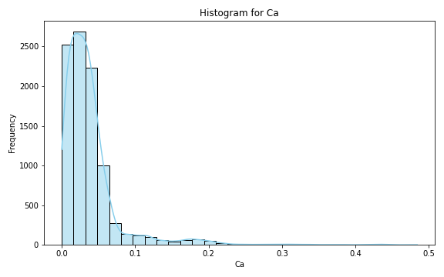
Analysis for column: Ca Model: Neural Network
Statistics:
mean 0.038354
std 0.042547
min 0.000005
25% 0.015223
50% 0.029738
75% 0.045146
80% 0.049933
85% 0.056205
90% 0.066279
95% 0.113511
99% 0.207799

Slide 5
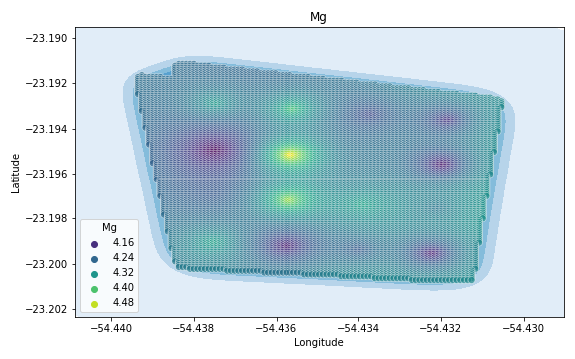
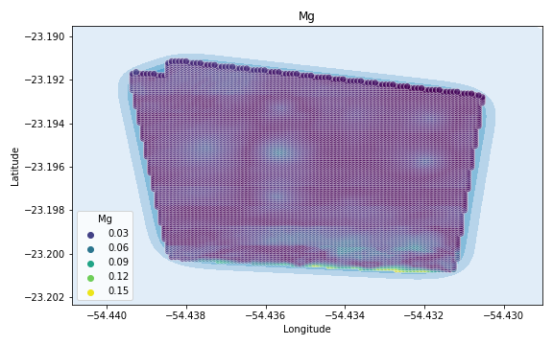
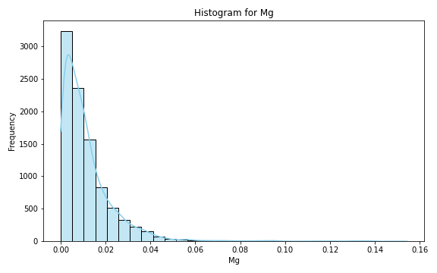
Analysis for column: Mg Model: Neural Network
Statistics:
mean 1.168868e-02
std 1.300198e-02
min 3.612792e-07
25% 3.582022e-03
50% 8.216917e-03
75% 1.520383e-02
80% 1.765428e-02
85% 2.107794e-02
90% 2.572774e-02
95% 3.391743e-02
99% 5.800098e-02

Slide 6
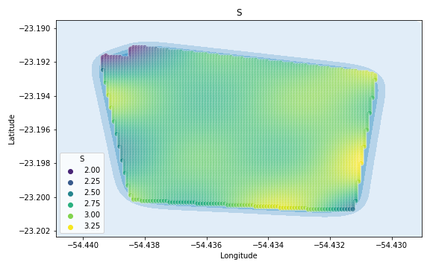
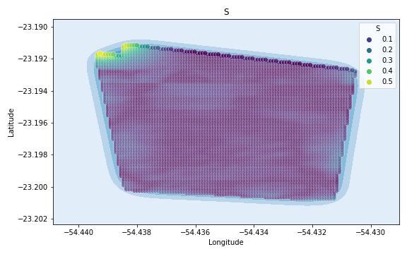
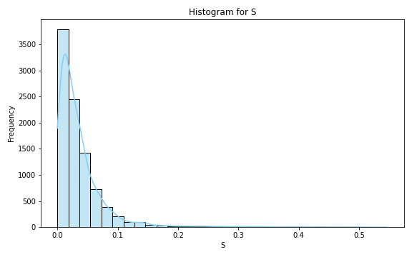
Analysis for column: S Model: Neural Network
Statistics:
mean 0.037809
std 0.049994
min 0.000012
25% 0.011280
50% 0.024459
75% 0.045220
80% 0.053009
85% 0.063632
90% 0.077891
95% 0.108633
99% 0.287768

Slide 7
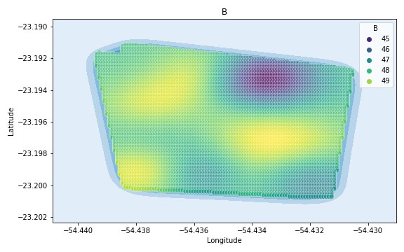
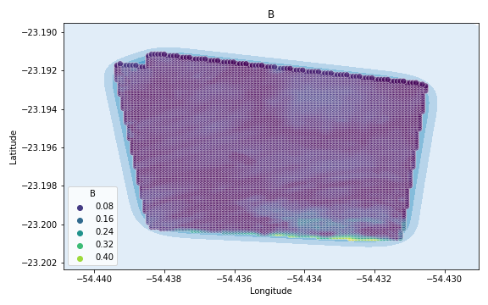
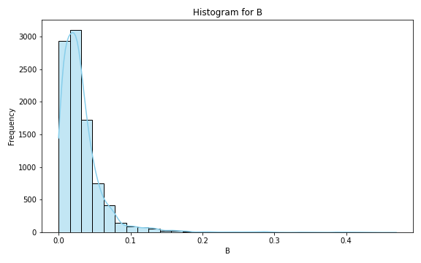
Analysis for column: B Model: Neural Network
Statistics:
mean 3.245234e-02
std 3.671007e-02
min 4.454105e-07
25% 1.279209e-02
50% 2.473563e-02
75% 3.955643e-02
80% 4.454821e-02
85% 5.169500e-02
90% 6.283163e-02
95% 8.260443e-02
99% 1.769230e-01

Slide 8
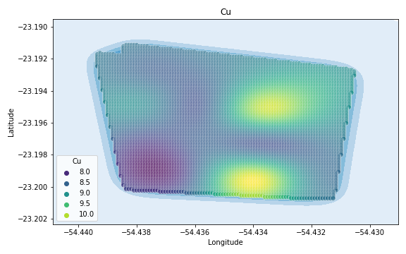
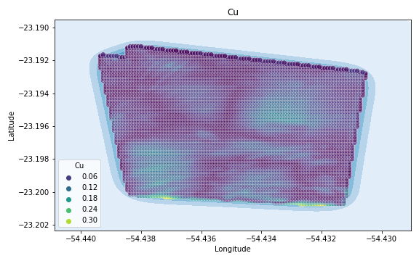
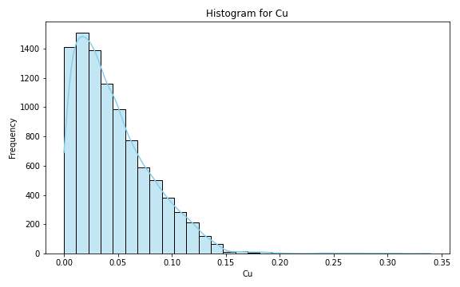
Analysis for column: Cu Model: Neural Network
Statistics:
mean 0.046175
std 0.036422
min 0.000010
25% 0.018600
50% 0.037725
75% 0.066014
80% 0.074130
85% 0.083769
90% 0.096202
95% 0.113792
99% 0.143013

Slide 9
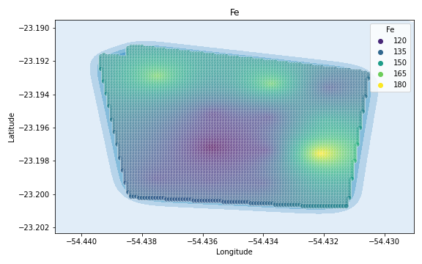
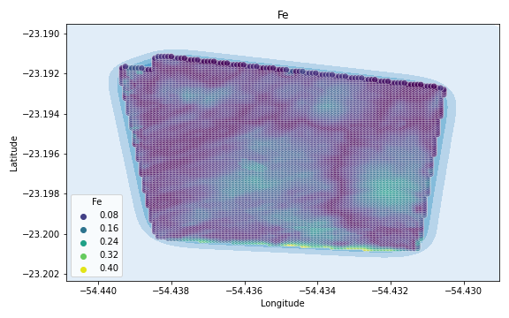
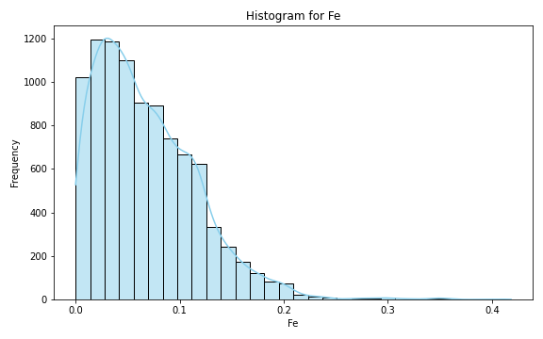
Analysis for column: Fe Model: Neural Network
Statistics:
mean 0.068563
std 0.050215
min 0.000031
25% 0.029766
50% 0.059018
75% 0.098796
80% 0.108874
85% 0.118092
90% 0.132172
95% 0.158680
99% 0.210432

Slide 10
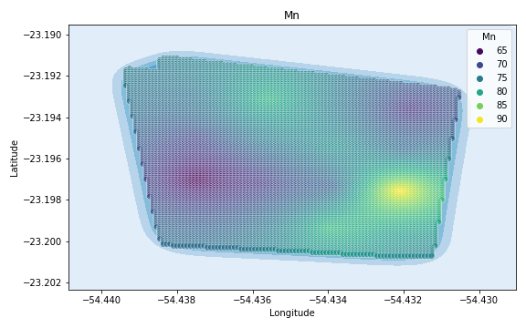
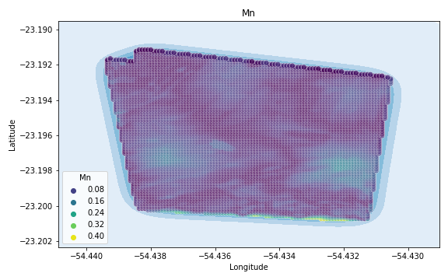
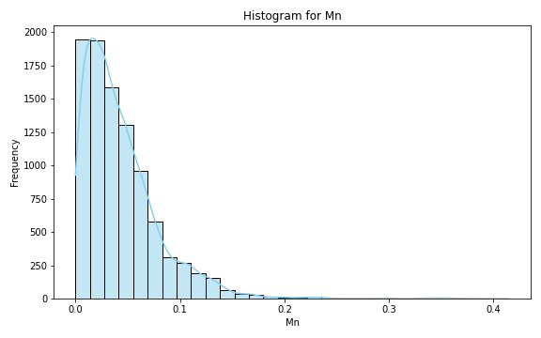
Analysis for column: Mn Model: Neural Network
Statistics:
mean 0.043839
std 0.038954
min 0.000005
25% 0.016797
50% 0.034430
75% 0.059487
80% 0.066185
85% 0.075647
90% 0.090869
95% 0.115374
99% 0.170501

Slide 11
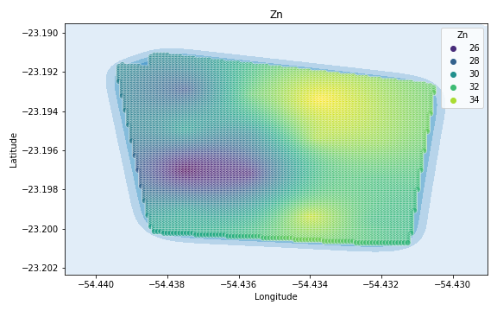
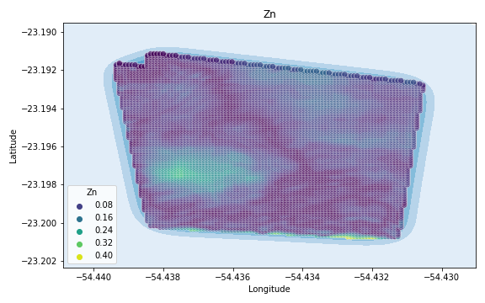
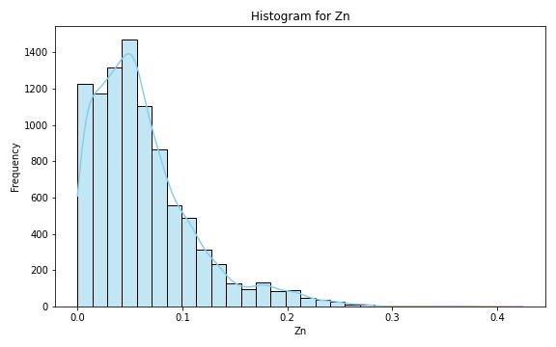
Analysis for column: Zn Model: Neural Network
Statistics:
mean 0.063166
std 0.050486
min 0.000005
25% 0.027915
50% 0.052587
75% 0.083641
80% 0.094210
85% 0.107468
90% 0.126577
95% 0.169656
99% 0.232227

Slide 12
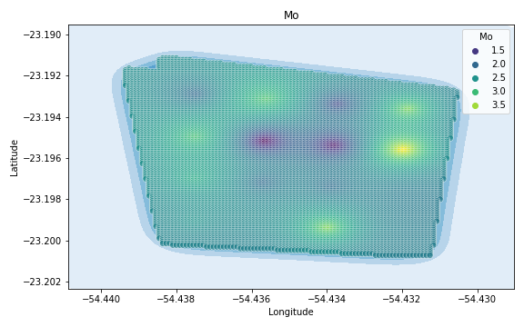
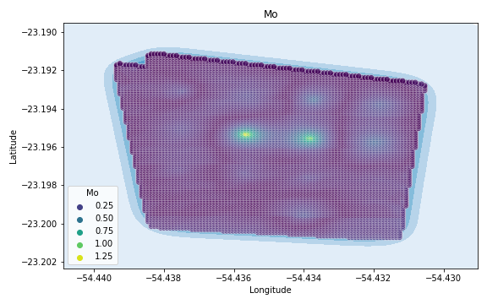
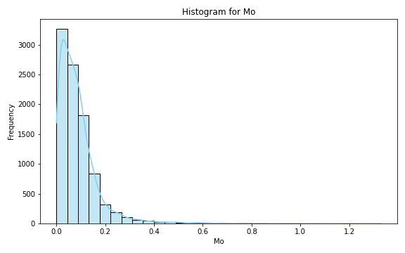
Analysis for column: Mo Model: Neural Network
Statistics:
mean 0.088087
std 0.093885
min 0.000012
25% 0.031200
50% 0.067874
75% 0.112240
80% 0.126426
85% 0.144812
90% 0.172208
95% 0.238841
99% 0.484436

Slide 13
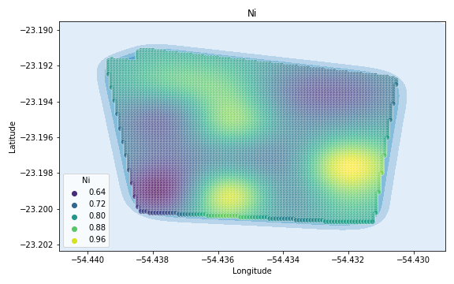
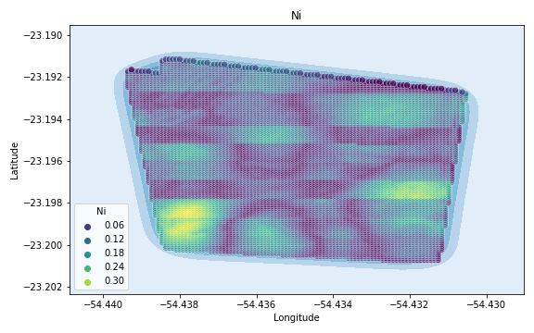
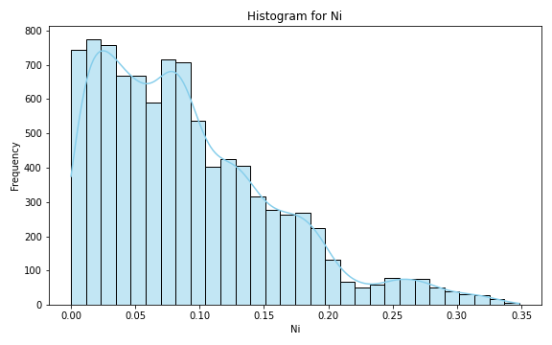
Analysis for column: Ni Model: Neural Network
Statistics:
mean 0.091193
std 0.068738
min 0.000020
25% 0.036505
50% 0.078271
75% 0.130714
80% 0.144997
85% 0.165113
90% 0.185433
95% 0.226654
99% 0.298568

Slide 14
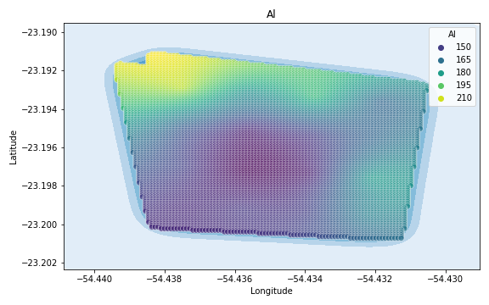
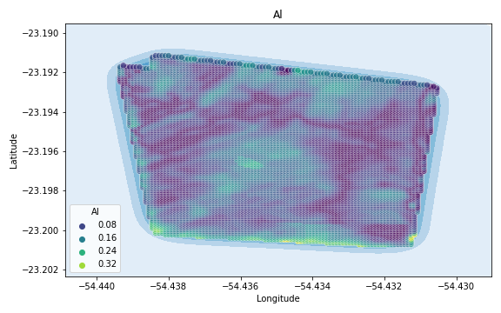
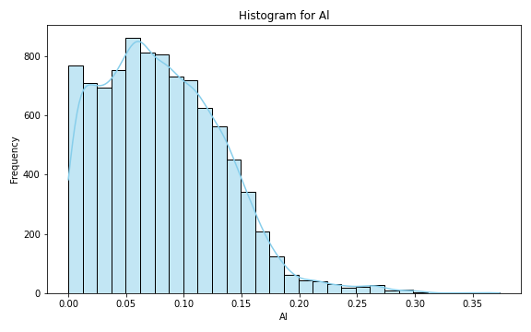
Analysis for column: Al Model: Neural Network
Statistics:
mean 0.082091
std 0.053413
min 0.000012
25% 0.041095
50% 0.076657
75% 0.116767
80% 0.126263
85% 0.136900
90% 0.150081
95% 0.171013
99% 0.245459

Slide 15
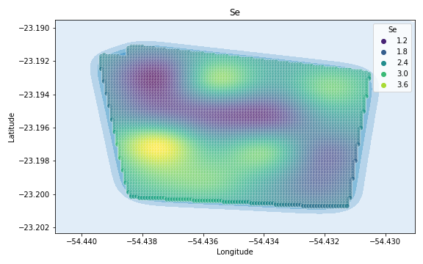
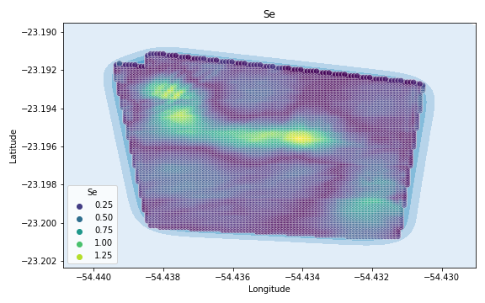
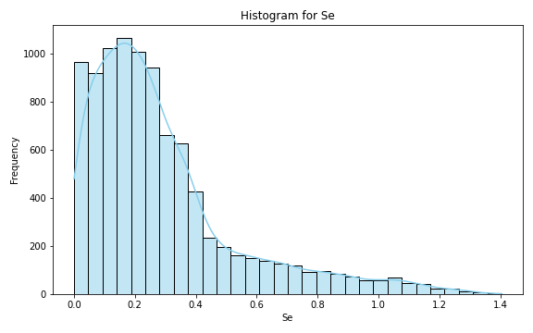
Analysis for column: Se Model: Neural Network
Statistics:
mean 0.289162
std 0.252625
min 0.000079
25% 0.116760
50% 0.222187
75% 0.367335
80% 0.413620
85% 0.509744
90% 0.655198
95% 0.863101
99% 1.144084

Slide 16
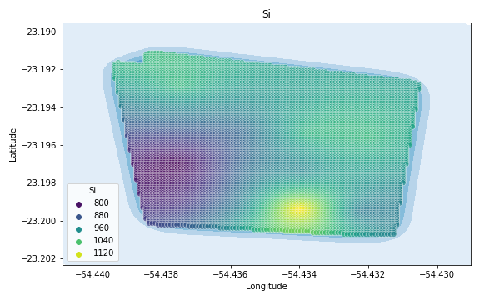
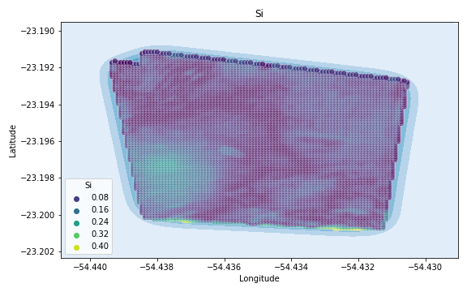
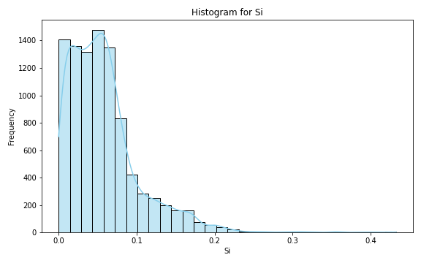
Analysis for column: Si Model: Neural Network
Statistics:
mean 0.057635
std 0.046453
min 0.000014
25% 0.024491
50% 0.049910
75% 0.074431
80% 0.082570
85% 0.095096
90% 0.118357
95% 0.151868
99% 0.205286

Slide 17
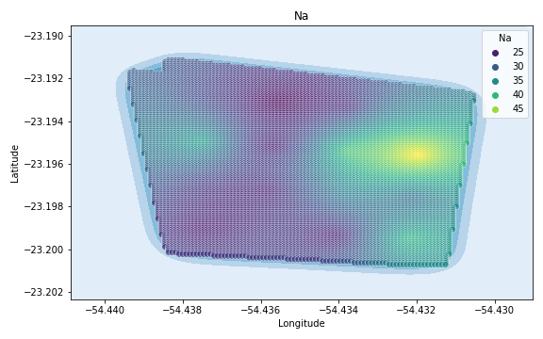
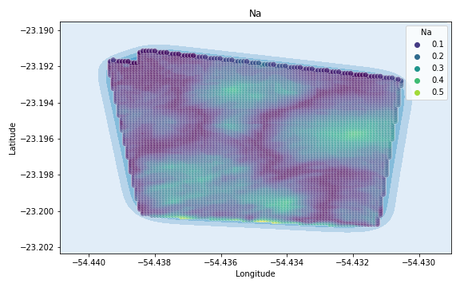

Analysis for column: Na Model: Neural Network
Statistics:
mean 0.133017
std 0.089226
min 0.000016
25% 0.059764
50% 0.122376
75% 0.198073
80% 0.216555
85% 0.235906
90% 0.258174
95% 0.289150
99% 0.351401

Slide 18



Analysis for column: Va Model: Neural Network
Statistics:
mean 0.088970
std 0.082800
min 0.000002
25% 0.026632
50% 0.063519
75% 0.121505
80% 0.144358
85% 0.178913
90% 0.220157
95% 0.265450
99% 0.349039

Slide 19



Analysis for column: DRIS_N Model: Neural Network
Statistics:
mean 0.338004
std 0.282530
min 0.000029
25% 0.113902
50% 0.257920
75% 0.515818
80% 0.568527
85% 0.637806
90% 0.722703
95% 0.864767
99% 1.122625

Slide 20



Analysis for column: DRIS_P Model: Neural Network
Statistics:
mean 0.374709
std 7.741027
min 0.000025
25% 0.067114
50% 0.143943
75% 0.264917
80% 0.299532
85% 0.344476
90% 0.421855
95% 0.661553
99% 2.396156

Slide 21



Analysis for column: DRIS_K Model: Neural Network
Statistics:
mean 3.040241
std 95.968213
min 0.000081
25% 0.176192
50% 0.389210
75% 1.121713
80% 1.464243
85% 1.889917
90% 2.761556
95% 4.938382
99% 25.486666

Slide 22



Analysis for column: DRIS_Ca Model: Neural Network
Statistics:
mean 3.286717
std 55.860603
min 0.000036
25% 0.153265
50% 0.310888
75% 0.523272
80% 0.732278
85% 1.242906
90% 2.842346
95% 7.919859
99% 37.397337

Slide 23



Analysis for column: DRIS_Mg Model: Neural Network
Statistics:
mean 0.159123
std 0.113418
min 0.000037
25% 0.068618
50% 0.143809
75% 0.229130
80% 0.250383
85% 0.272012
90% 0.298894
95% 0.369145
99% 0.502932

Slide 24



Analysis for column: DRIS_S Model: Neural Network
Statistics:
mean 5.863356
std 202.195564
min 0.000051
25% 0.547435
50% 0.844217
75% 1.533311
80% 1.940178
85% 2.505909
90% 3.633766
95% 6.908055
99% 31.542523

Slide 25



Analysis for column: DRIS_B Model: Neural Network
Statistics:
mean 0.348037
std 0.438486
min 0.000084
25% 0.115176
50% 0.226218
75% 0.337638
80% 0.385567
85% 0.522126
90% 0.821933
95% 1.327756
99% 2.291988

Slide 26



Analysis for column: DRIS_Cu Model: Neural Network
Statistics:
mean 0.077747
std 0.065753
min 0.000004
25% 0.028017
50% 0.062506
75% 0.107772
80% 0.123338
85% 0.139994
90% 0.162019
95% 0.216598
99% 0.296760

Slide 27



Analysis for column: DRIS_Fe Model: Neural Network
Statistics:
mean 0.262459
std 0.239964
min 0.000108
25% 0.105558
50% 0.204989
75% 0.322137
80% 0.350894
85% 0.405179
90% 0.562691
95% 0.853539
99% 1.163456

Slide 28



Analysis for column: DRIS_Mn Model: Neural Network
Statistics:
mean 0.253946
std 0.232507
min 0.000185
25% 0.084990
50% 0.192184
75% 0.343326
80% 0.400434
85% 0.461847
90% 0.545723
95% 0.731930
99% 1.123090

Slide 29



Analysis for column: DRIS_Zn Model: Neural Network
Statistics:
mean 0.264351
std 0.195043
min 0.000099
25% 0.113680
50% 0.230249
75% 0.367151
80% 0.414413
85% 0.462255
90% 0.535436
95% 0.650148
99% 0.840393

Slide 30



Analysis for column: IMS Model: Neural Network
Statistics:
mean 0.324441
std 0.286779
min 0.000019
25% 0.103969
50% 0.244914
75% 0.447355
80% 0.524647
85% 0.634389
90% 0.762280
95% 0.957911
99% 1.192415

Slide 31



Analysis for column: IBN Model: Neural Network
Statistics:
mean 0.079897
std 0.064687
min 0.000001
25% 0.028772
50% 0.064447
75% 0.116820
80% 0.131959
85% 0.147917
90% 0.168227
95% 0.212460
99% 0.278236

